Slide 1
Technology-enhanced classrooms for Camden Public Schools: rt cream, east camden middle school and woodrow wilson high school
Center for Building Knowledge at NJIT

Slide 2
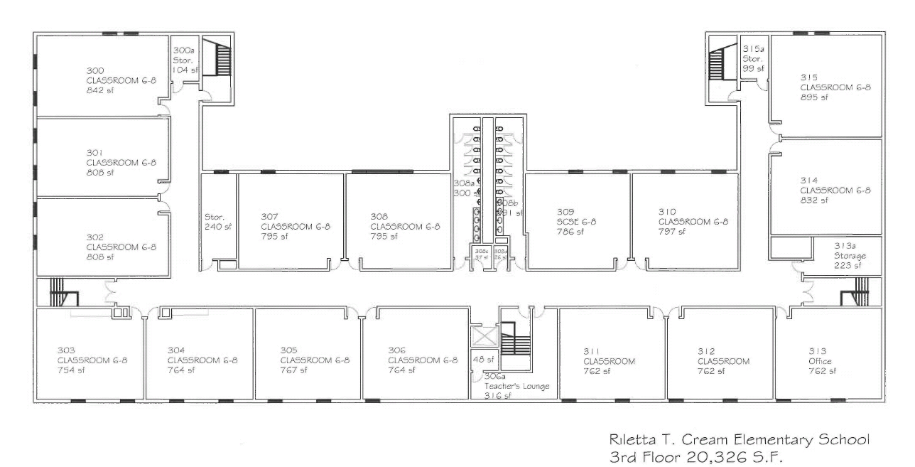
RT Cream - 312
Room 312 will become a Pilot Classroom.

Slide 3
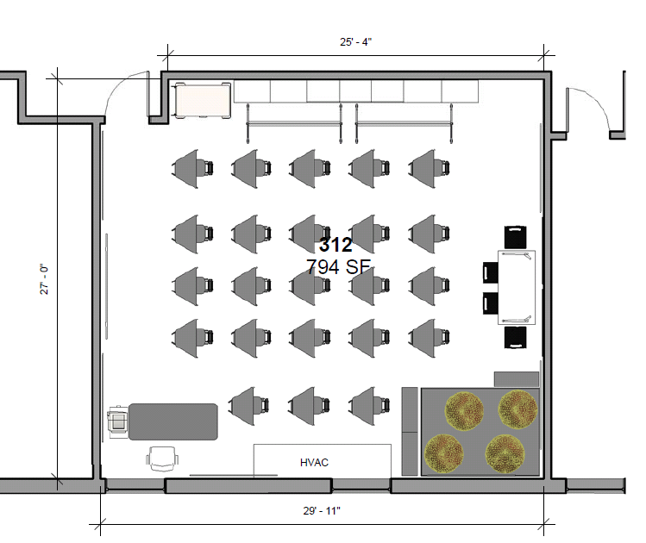
RT Cream - 312
Storage
Media Cart
Movable White Board
Student Desks and Chairs
Table and Chairs (Listening Station)
Teaching Wall
Teacher’s Station
Classroom
Library

Slide 4
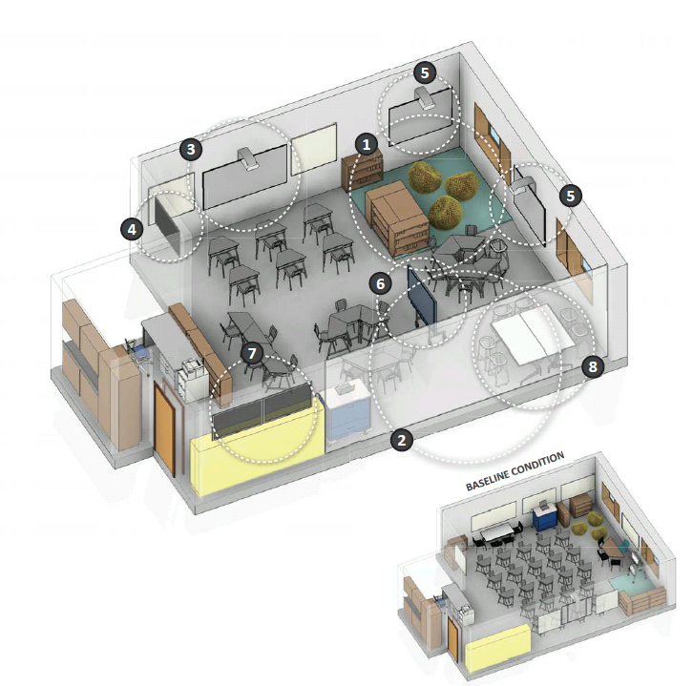
RT Cream - 312
Sample of how furniture can be re-arranged to form small group stations from study of Newark Public Schools.

Slide 5
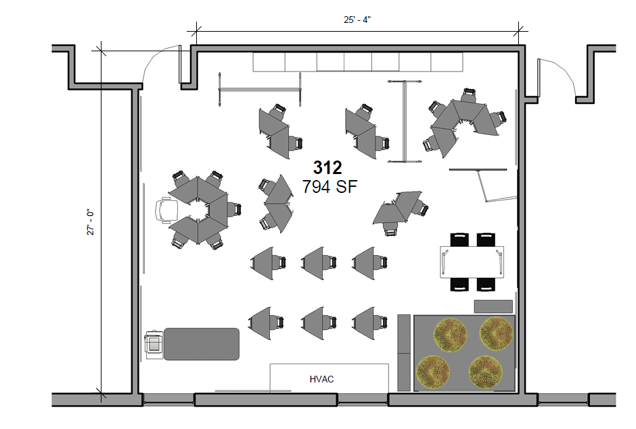
RT Cream – 312 – Alt 1
Articulated Flat Screen Display
Multiple Uses including individual and small group work.

Slide 6
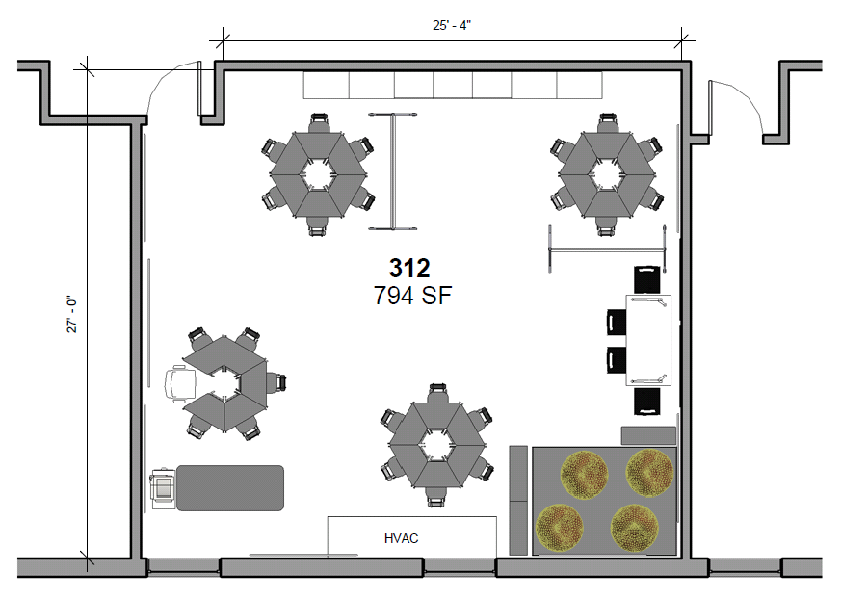
RT Cream – 312 – Alt 2
Small Group work and ‘Guided Reading’ scenario.

Slide 7
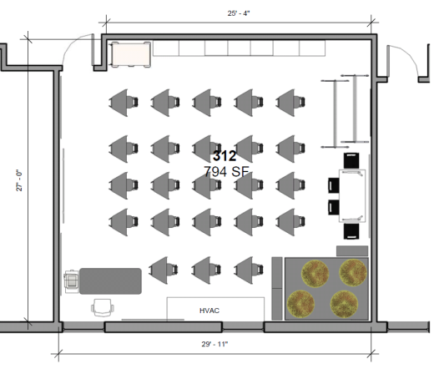
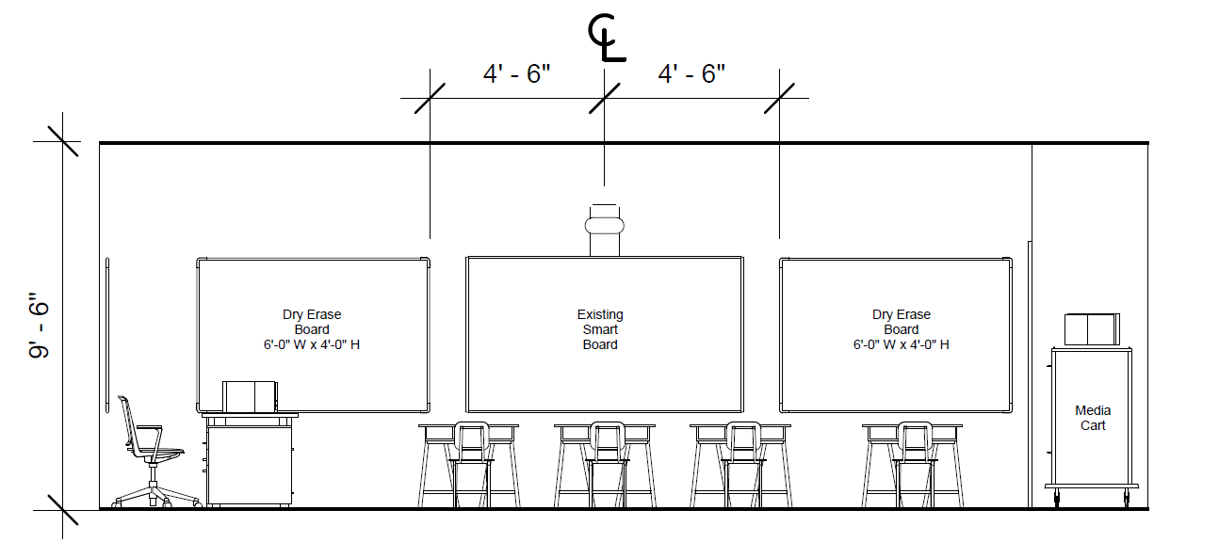
RT Cream - 312

Slide 8
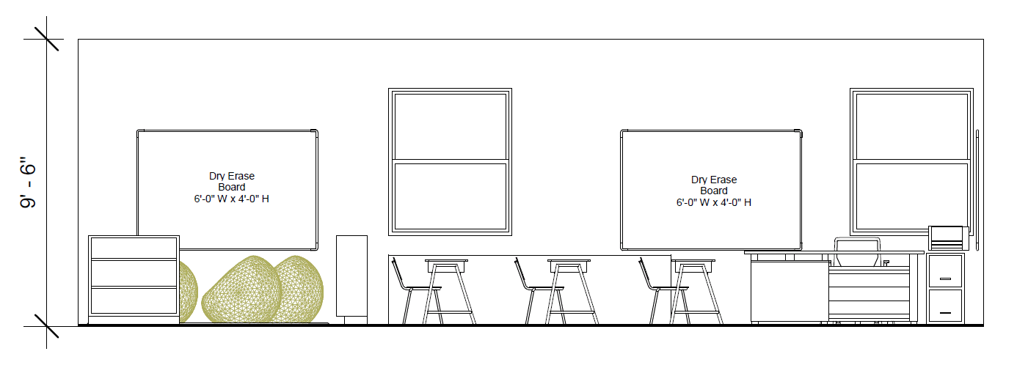
RT Cream - 312

Slide 9
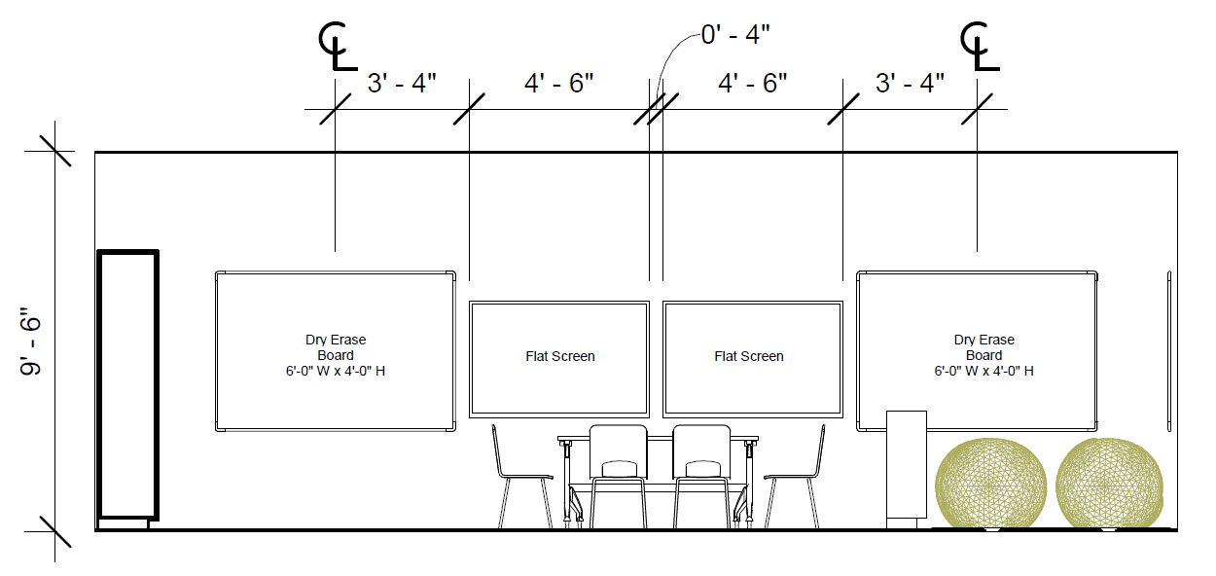
RT Cream - 312

Slide 10
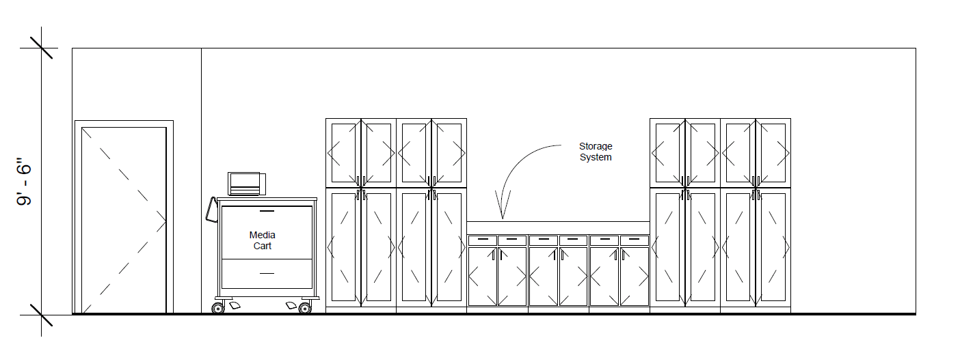
RT Cream - 312

Slide 11
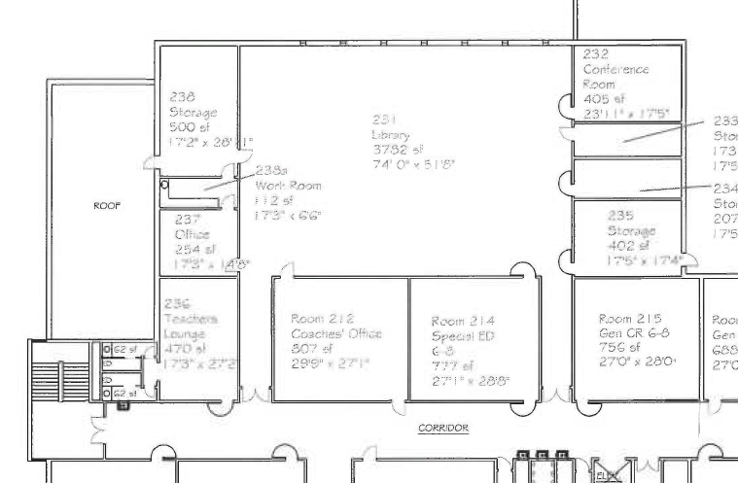
East Camden Middle School - 214
Room 214 will become a Professional Development Lab.

Slide 12
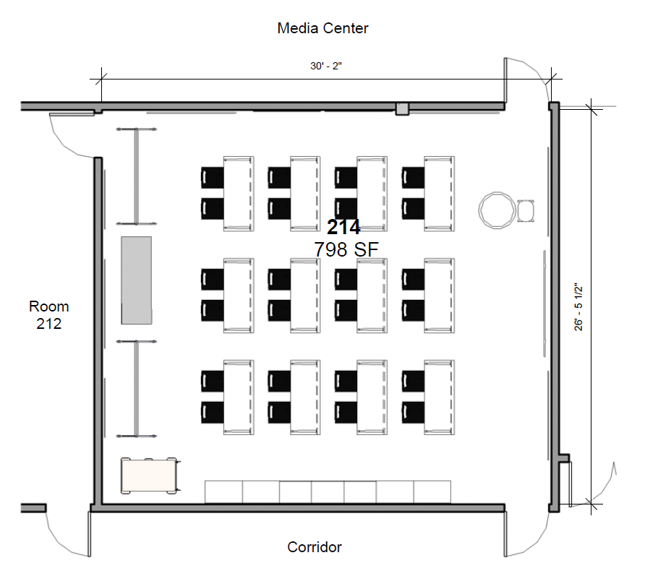
East Camden Middle School - 214
Movable whiteboard
Teacher Station
Existing Distance Learning Equipment
Folding Tables and Chairs
Media Cart
Storage

Slide 13
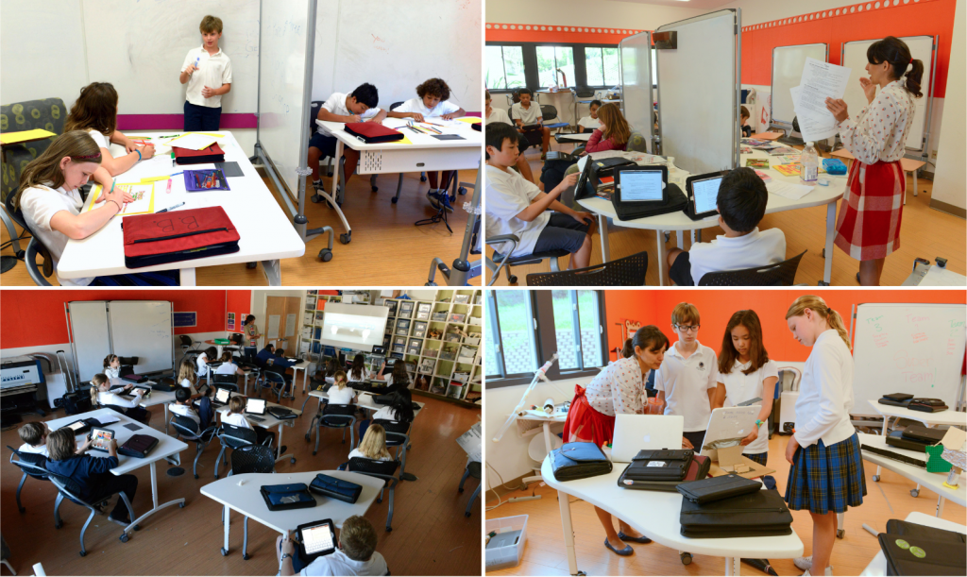
Hillbrook iLab

Slide 14
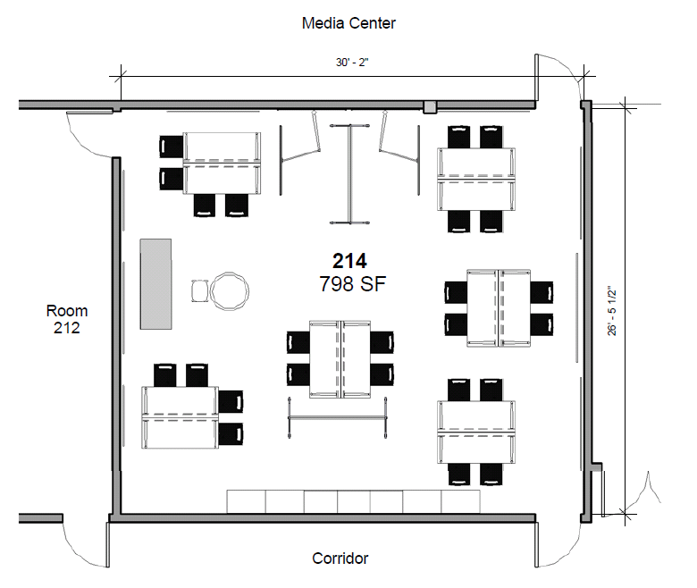
East Camden Middle School – 214 – Alt 1
Articulated Flat Screen Display

Slide 15
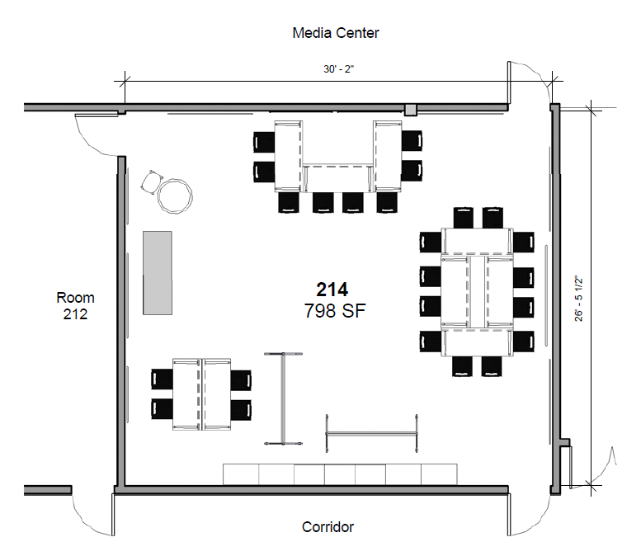
East Camden Middle School – 214 – Alt 2
*Three tables not shown are folded to the side

Slide 16
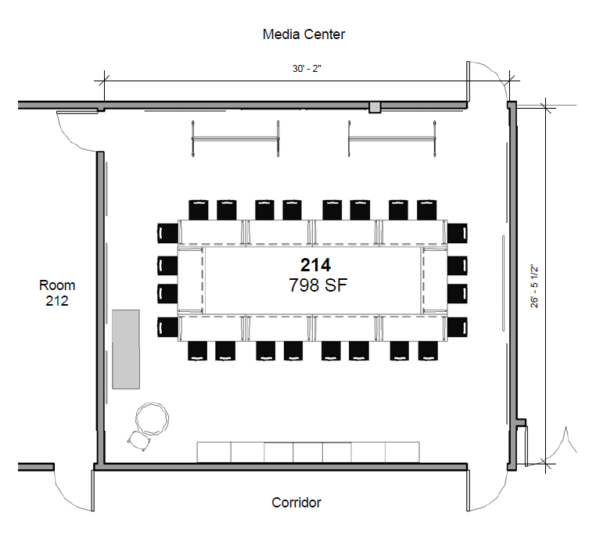
East Camden Middle School – 214 – Alt 3
*Two tables not shown are folded to the side

Slide 17
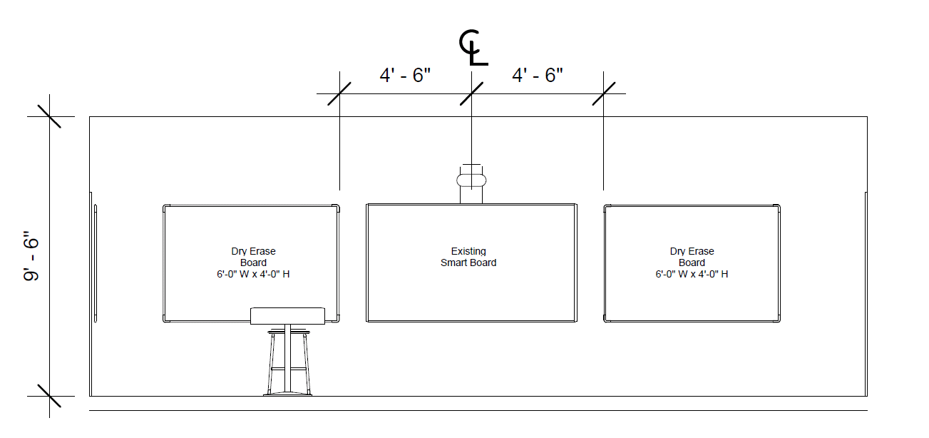
East Camden Middle School - 214

Slide 18
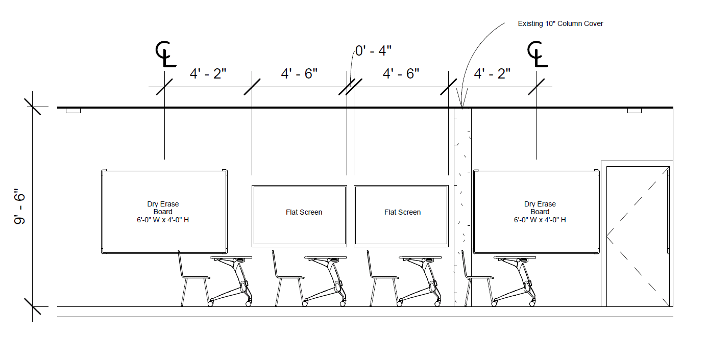
East Camden Middle School - 214

Slide 19
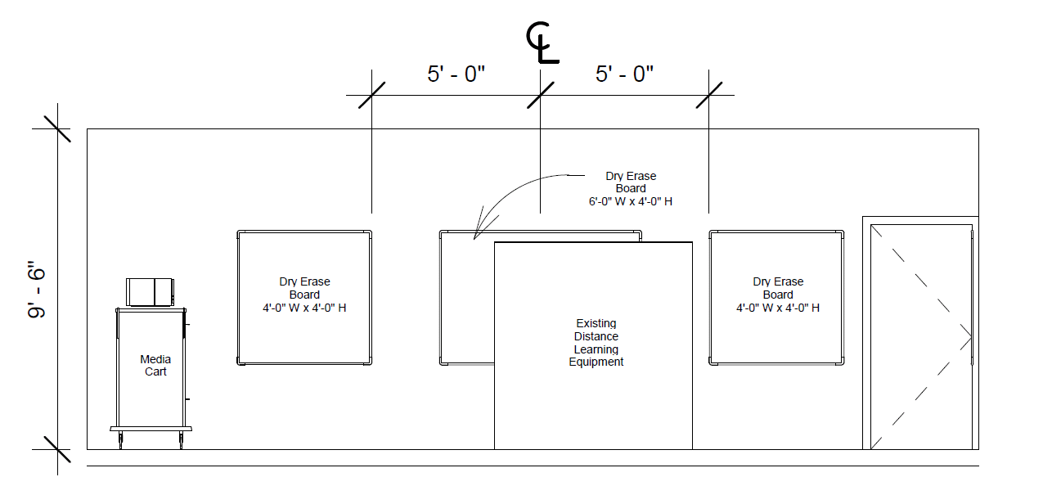
East Camden Middle School - 214

Slide 20
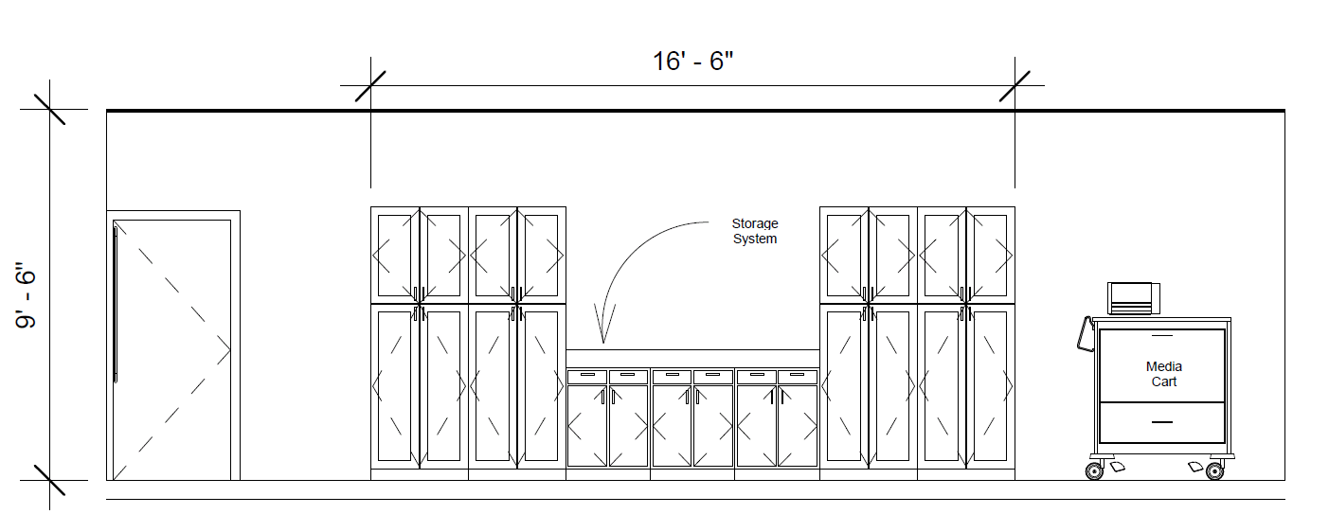
East Camden Middle School - 214

Slide 21
Woodrow Wilson High School - 217
Room 217 will become a Learning Lab.

Slide 22
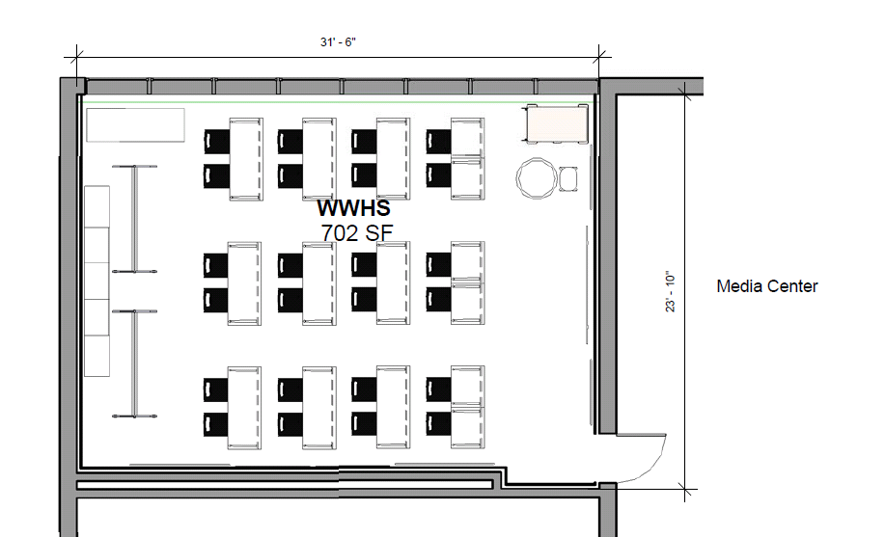
Woodrow Wilson High School - 217
Existing Distance Learning Equipment
Media Cart
Teacher Station
Movable whiteboard
Folding Tables and Chairs
Storage

Slide 23
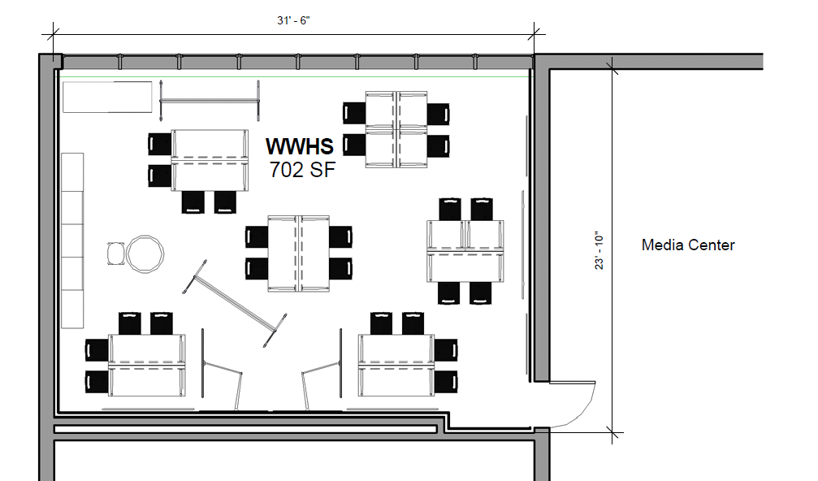
Woodrow Wilson High School – 217 – Alt 1
Articulated Flat Screen Display

Slide 24
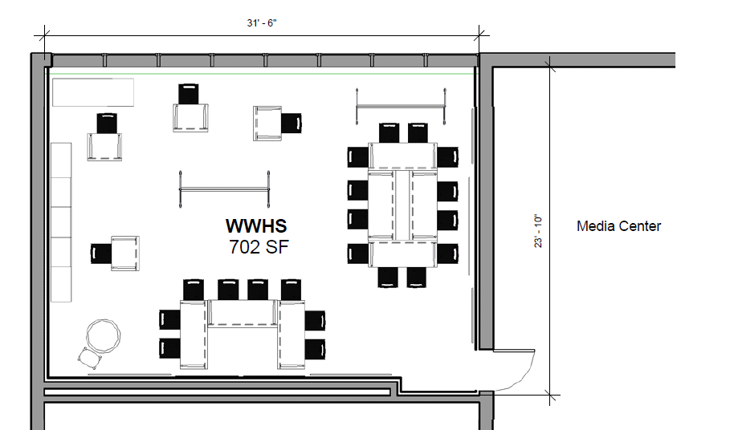
Woodrow Wilson High School – 217 – Alt 2
*Three tables not shown are folded to the side

Slide 25
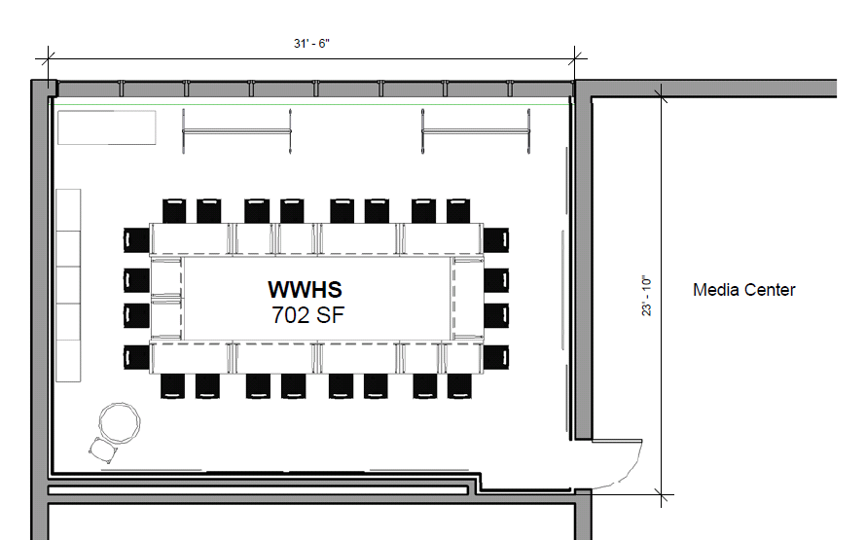
Woodrow Wilson High School – 217 – Alt 3
*Two tables not shown are folded to the side

Slide 26
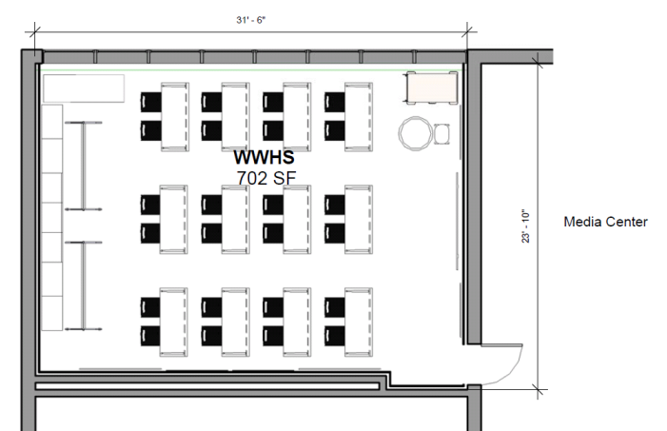
Woodrow Wilson High School - 217

Slide 27
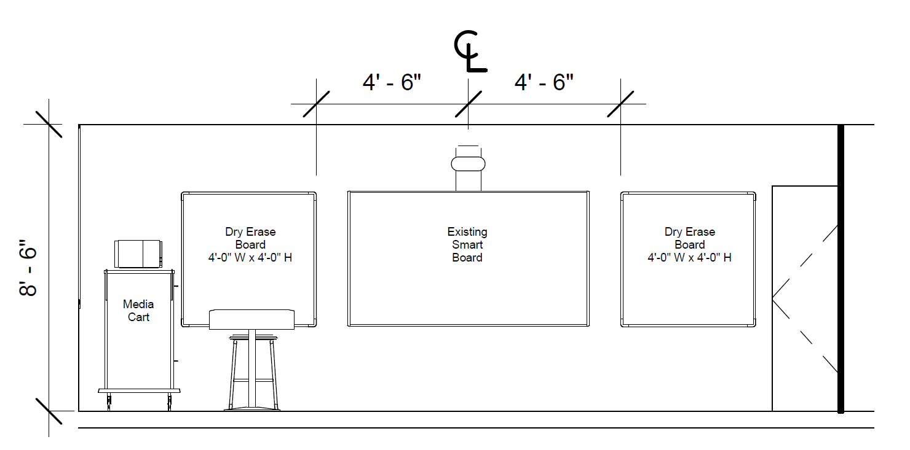
Woodrow Wilson High School - 217

Slide 28
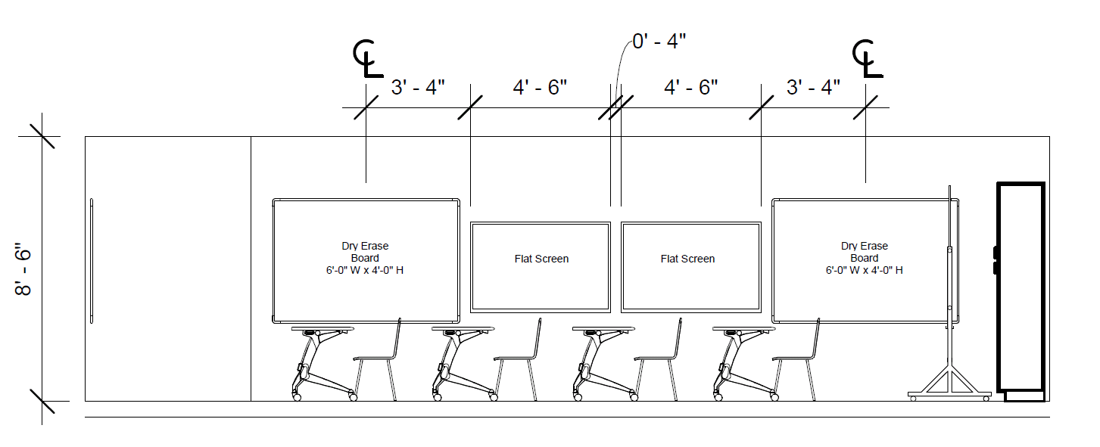
Woodrow Wilson High School - 217

Slide 29
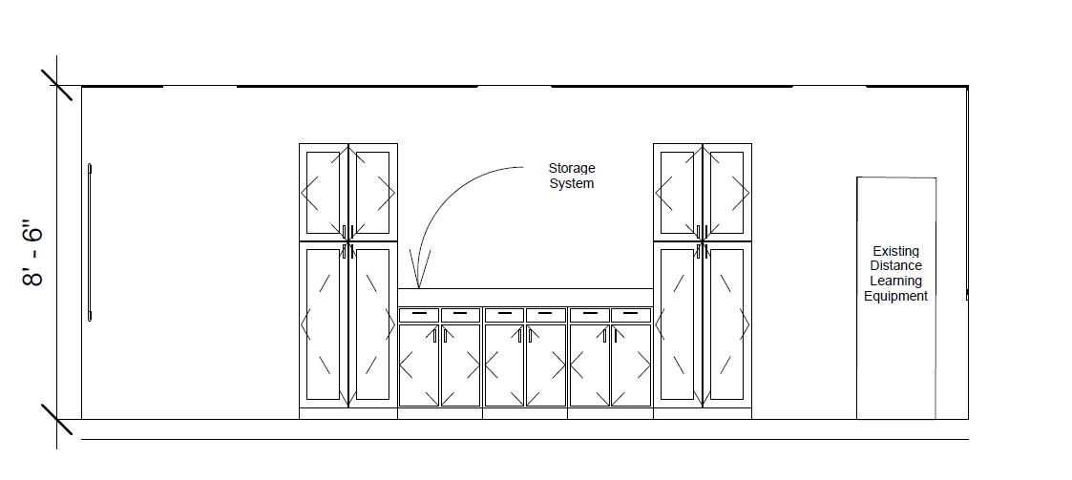
Woodrow Wilson High School - 217

