Slide 1
Challenges of Borehole Communication in Oil Wells
Ali Abdi, PhD
Electrical & Computer Engineering Dept., NJIT
PhD advisee: A. Alenezi
CWCSPR Research Day
March 29, 2016

Slide 2
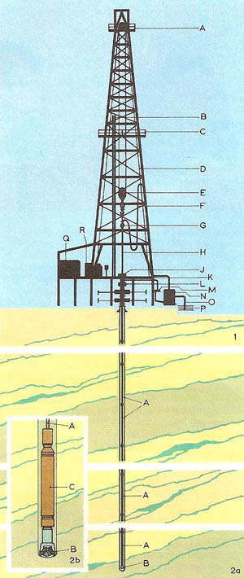
Extraction of Oil and Gas
Drill string underneath an oil rig
Image from http://www.daviddarling.info/encyclopedia/P/petroleum.html
Oil and natural gas reservoirs are located more than 2 miles underground
Have to drill wells to extract oil and gas
The drill operator needs to have information about the environment that facing the drill bit.
Different sensors placed close to the drill bit to gather information about the parameters downhole, e.g., pressure, temperature, torque, …

Slide 3
Why Logging While Drilling?
Reduce the cost of well drilling
Avoid drilling risks
Reduce the time of drilling operations
A Short Video
Black Gold, Part 1, Watch 1:50-3:20

Slide 4
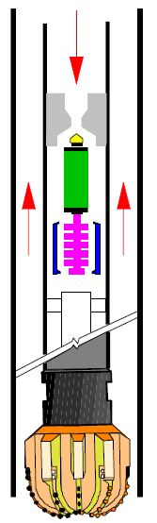
Telemetry Methods
Wireline Telemetry
Interferes with drilling operations
Expensive
Prone to failure
Mud-Pulse Telemetry
Very low data rates, typically less than 10 bits/sec.

Slide 5
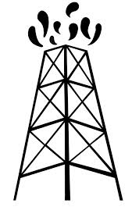




Wireless Telemetry Using Acoustic Waves
Rx
Advantage
Acoustic waves can carry data up and down the drill-string without interrupting the drilling
Challenges
Attenuation and reflections due to impedance mismatch at the pipes joints
Downhole and surface noise sources produce substantial in-band noise power
Figure from “Acoustic channel model for adaptive downhole communication over deep drill strings,” M. A. Gutierrez-Estevez, et al., ICASSP 2013.
Tx

Slide 6



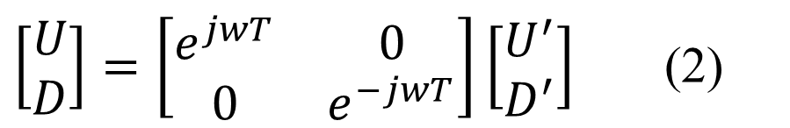







Acoustic Wave Propagation in Drill Strings
$$U_{2}^{′}=t_{2}^{′} U_{1}+r_{2}^{′}D_{2}^{′}$$
$D_{1}=r_{1}U_{1}+t_{1}D_{2}^{′}$ (1)
U: Up-going wave
D: Down-going wave
$$D_{2}^{′}$$
$$U_{2}^{′}$$
$$D_{1}$$
$$U_{1}$$
$$D$$
$$U$$
$\left[\begin{matrix}U \\ D\end{matrix}\right]=\left[\begin{matrix}e^{jwT} & 0 \\ 0 & e^{−jwT}\end{matrix}\right]\left[\begin{matrix}U^{′} \\ D^{′}\end{matrix}\right]$ (2)
$$L$$
$$D^{′}$$
$$U^{′}$$

Slide 7

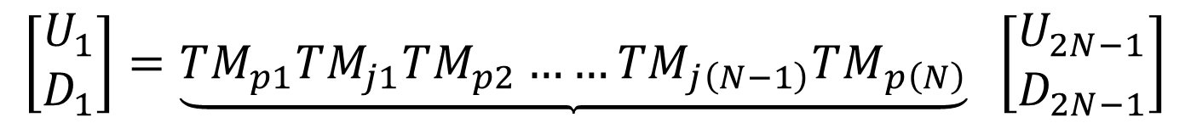




Acoustic Wave Propagation in Drill Strings (cont’d)
$$TM_{p}=\frac{1}{t}\left[\begin{matrix}e^{−jwT_{1}} & re^{−jwT_{1}} \\ re^{jwT_{1}} & e^{jwT_{1}}\end{matrix}\right]$$
$TM_{j}=\frac{1}{t}\left[\begin{matrix}e^{−jwT_{2}} & re^{−jwT_{2}} \\ re^{jwT_{2}} & e^{jwT_{2}}\end{matrix}\right]$
$$Rx$$
$$L_{1}$$
$$L_{2}$$
$$\left[\begin{matrix}U_{1} \\ D_{1}\end{matrix}\right]=\underbrace{TM_{p1}TM_{j1}TM_{p2}……TM_{j\left(N−1\right)}TM_{p\left(N\right)}} \left[\begin{matrix}U_{2N−1} \\ D_{2N−1}\end{matrix}\right]$$
$$Tx$$

Slide 8




Drill String Channel Model Using Transfer Matrix Method
$$L_{1}$$
$U_{1}$ $D_{1}$
$U_{2N−1}$ $D_{2N−1}$
$$L_{2}$$

Slide 9
Additive Noise
There are two main noise sources:
    Surface Noise
    Drill-bit Noise
Noise power is comparable to the received signal power
Surface noise is the dominant noise
Figure from “Directional propagation cancellation for acoustic communication along the drill string,” S. Sinanovic, et al., ICASSP 2006

Slide 10
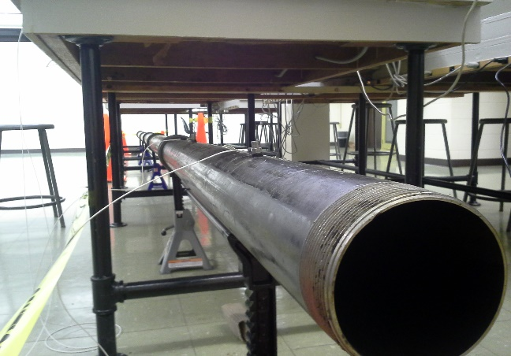
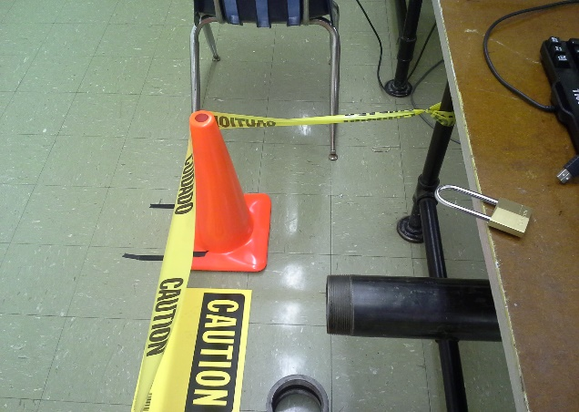
Laboratory Setup
- Drill string constructed using 6 pipes and 5 tool-joints.
- Two accelerometers to measure signal at the other end.

Slide 11
Excited one end of the drill-string using a steel tool
Impulse and frequency responses of the signal are shown below.
We can see the stop-bands and pass-bands in the frequency response.

Slide 12
Excited one end of the drill-string using a steel tool (cont’d)
Zoomed in frequency responses are shown below.
Both sensors show almost similar response.

Slide 13
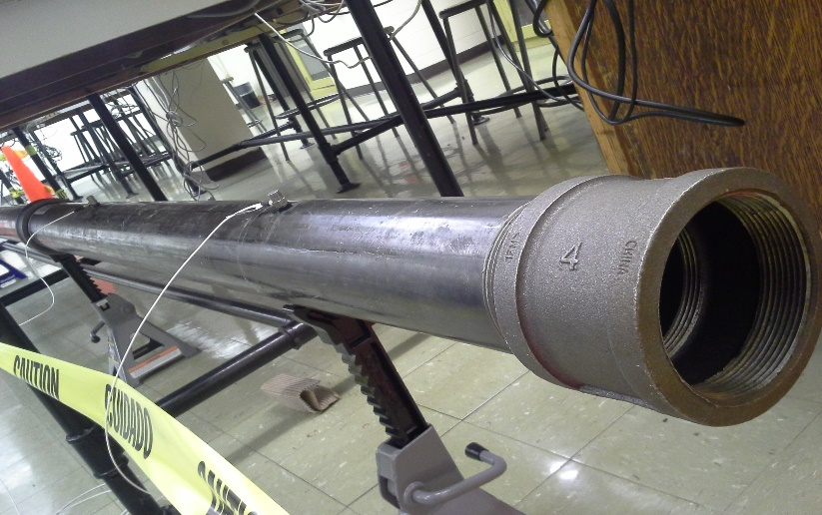
Drill-string with a tool-joint added to the receiver pipe’s end

Slide 14
Drill-string with a tool-joint added to the receiver pipe’s end (cont’d)

Slide 15
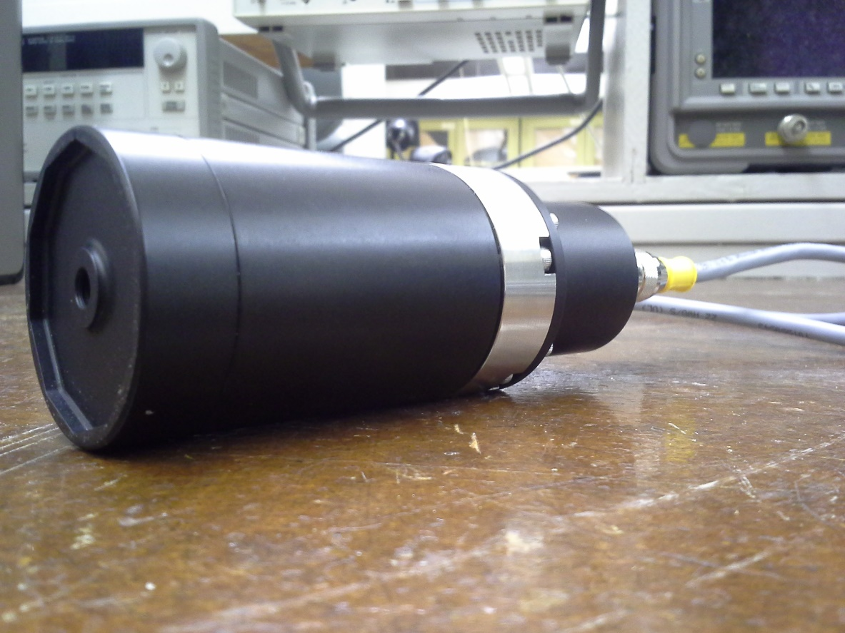
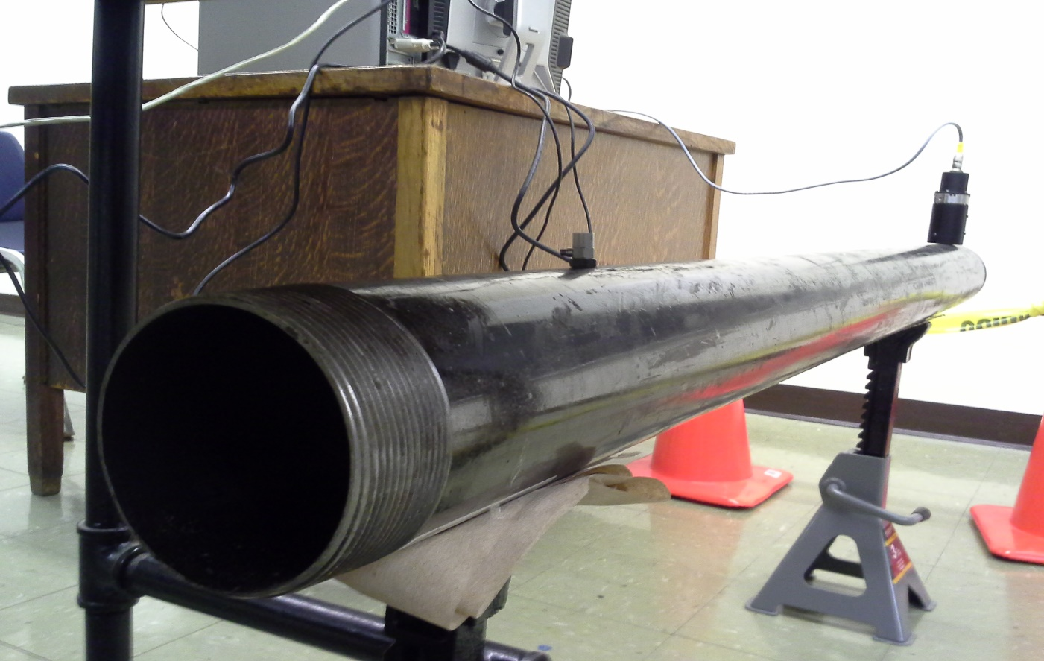
Ultrasonic Actuator
The Magnetostrictive transducer can generate signals with frequency up to 20 KHz.

Slide 16
Ultrasonic Actuator (cont’d)
Transmitting a sinusoidal signal at 18 KHz over a single pipe

Slide 17
Work in Progress
Optimal equalizer and preprocessor design
More effective noise cancellation methods

Slide 18
Thank you!

