Slide 1
The US Current Account Deficit Problem
Jeffrey Shafer
November 3-4, 2017

Slide 2
The US Current Account Balance and
Broad Real Dollar Exchange Rate Index
R=-.2

Slide 3
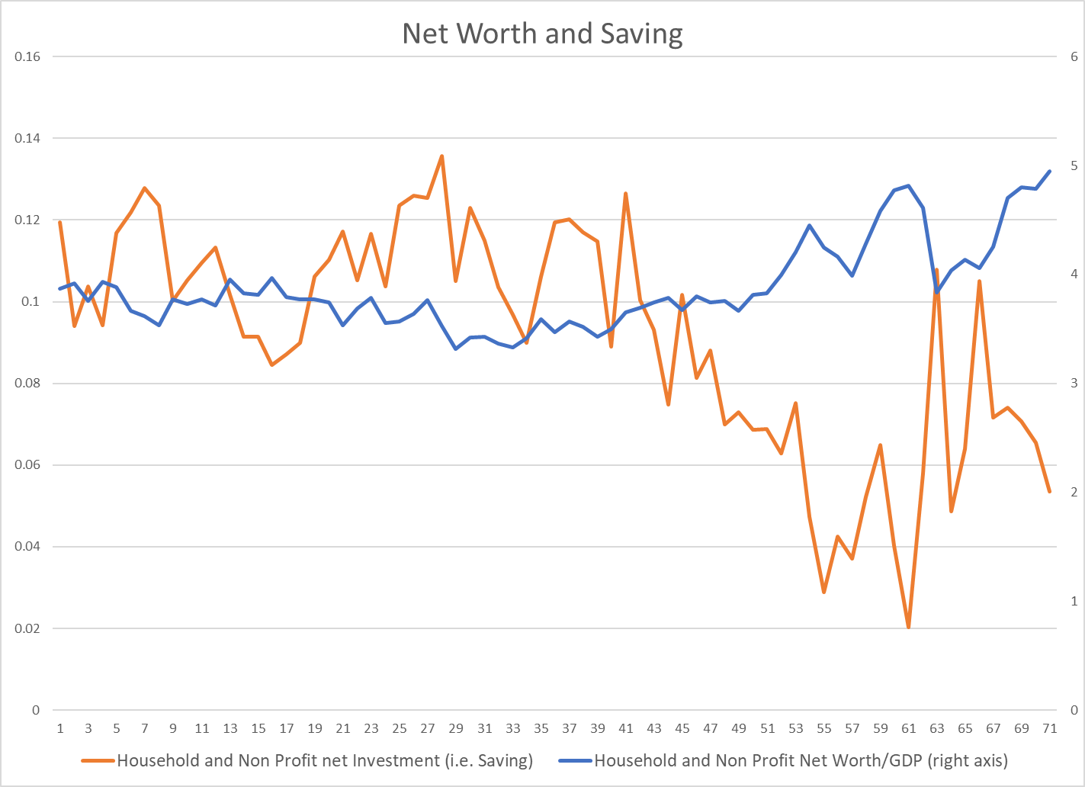
Monetary policy through asset prices drives saving as well as investment (r=.73)
Federal Reserve Financial Accounts of the US

Slide 4
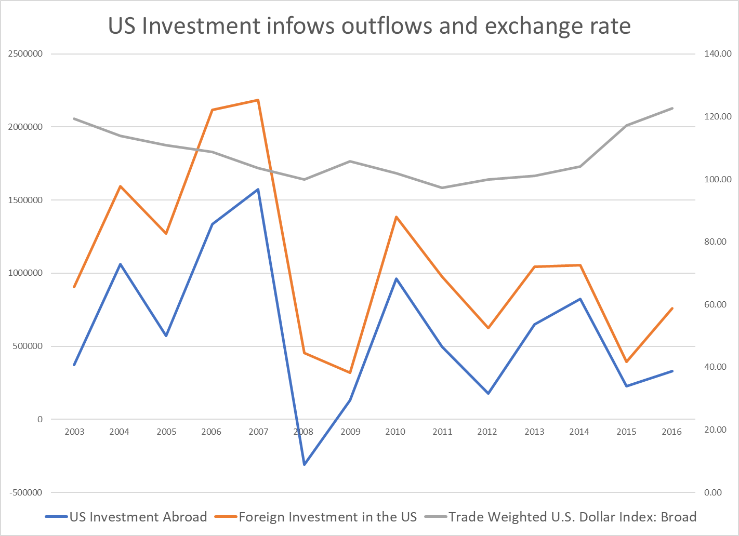
US Capital Outflows Follow Inflows (or Vice Versa?)
BEA US International Transactions

