Slide 1
Economic booms with and without capital controls: A case study of Iceland
Gylfi Zoega
University of Iceland and Birkbeck College, London
Leir Retreat Center
3-4 November 2017

Slide 2
Two economic booms:
2003-2008:
Interest rates raised to stem domestic demand but free flow of capital and foreign currency borrowing allowed. Banks required to have an FX balance on their books.
2010-2017:
Interest rates raised to lower the growth of domestic demand and increase domestic savings but capital controls imposed. Capital account closed until 2016 and an “Aliber tax” imposed in June 2016 (foreign residents have to deposit 40% of investment in domestic bonds into an interest-free account at the central bank).

Slide 4
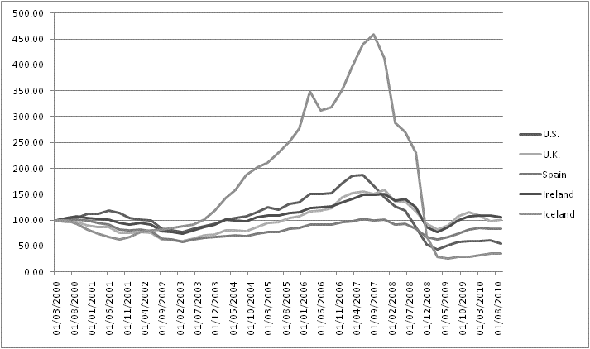
Share prices (IMF-IFS)

Slide 5
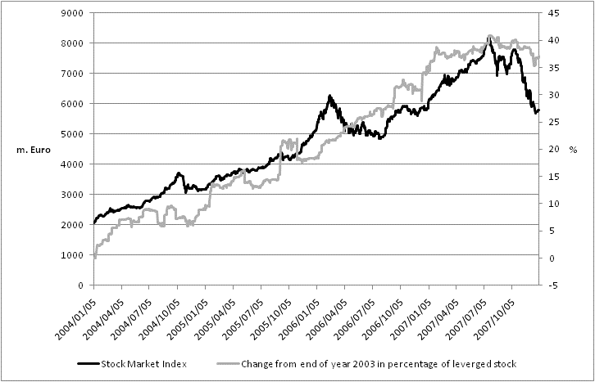
Stock prices and the share of leveraged stock

Slide 6
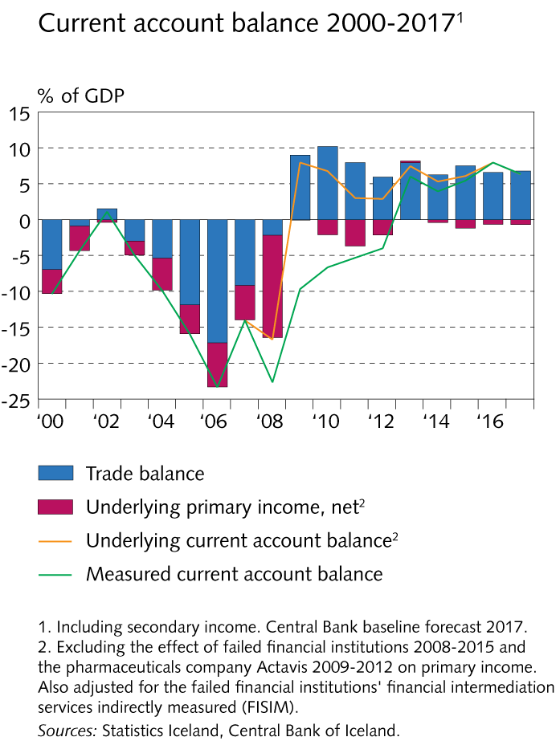
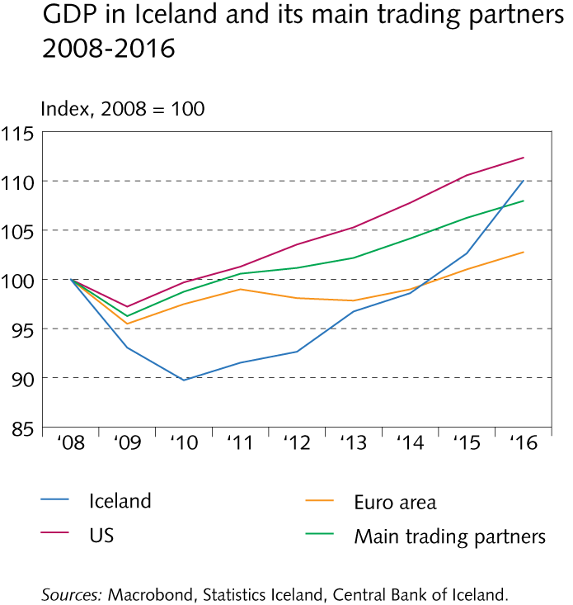

Slide 7
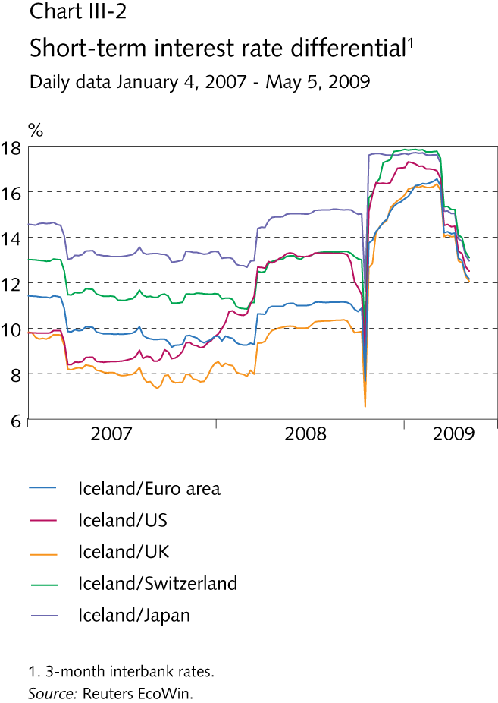
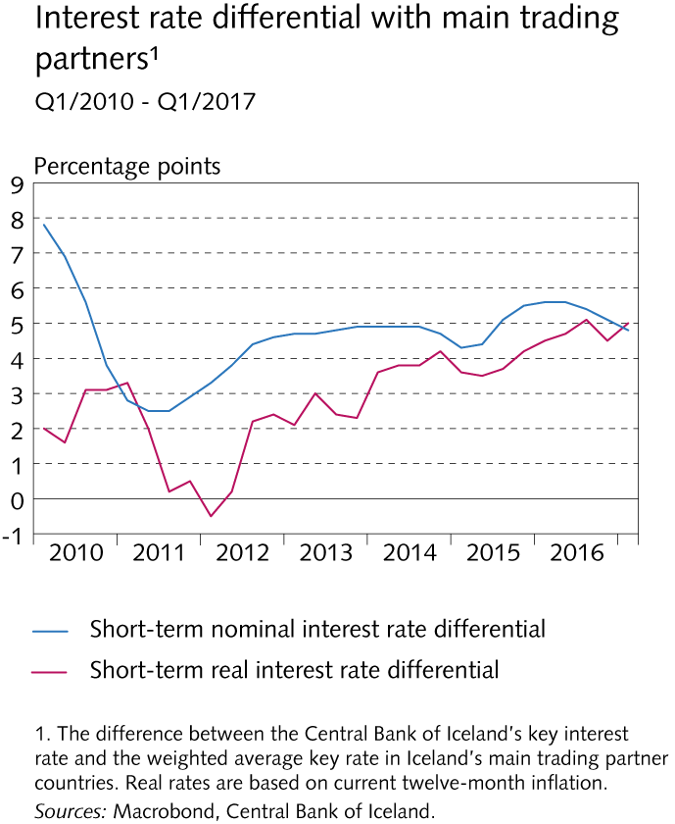

Slide 8
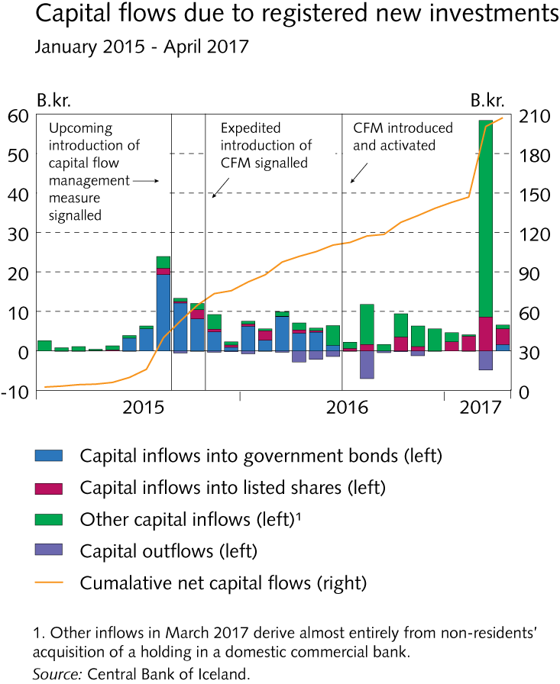
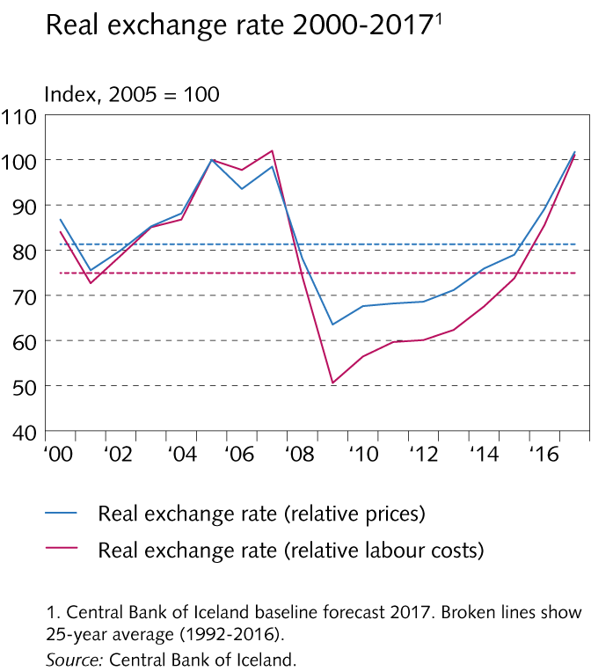

Slide 9
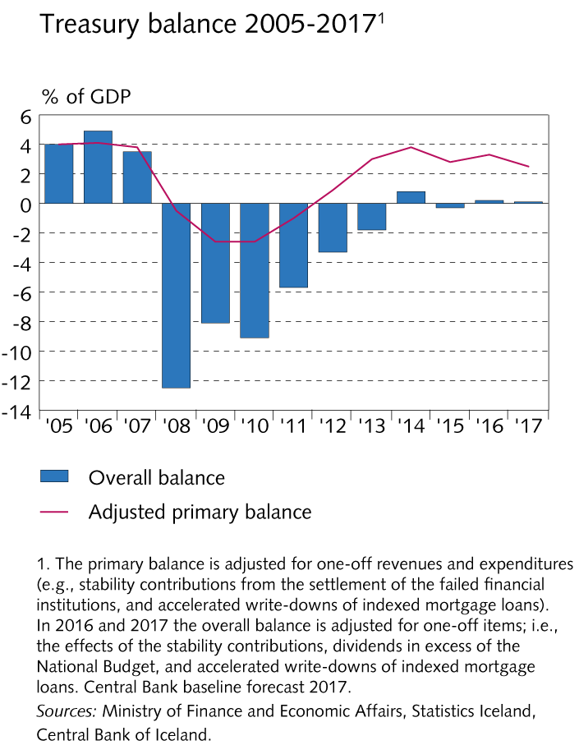
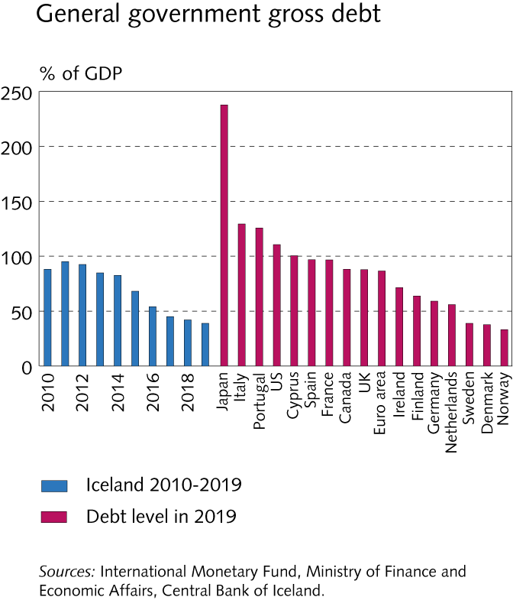
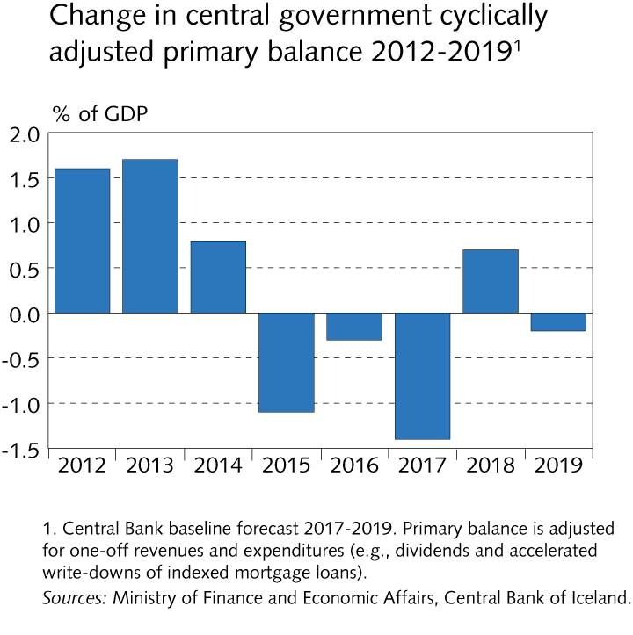

Slide 10
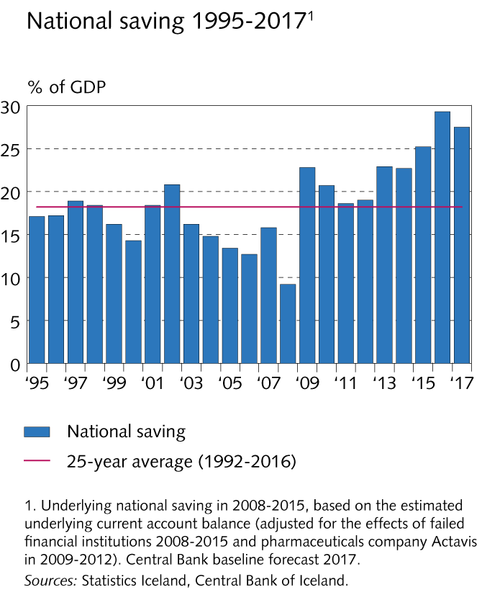
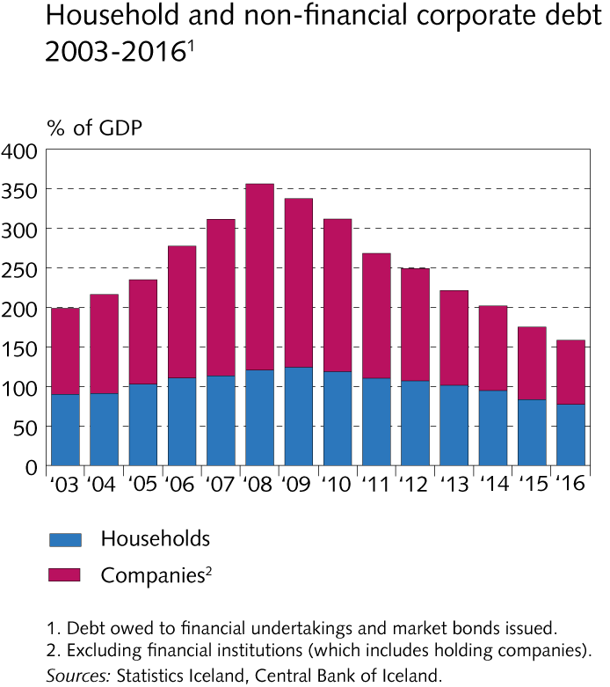

Slide 11
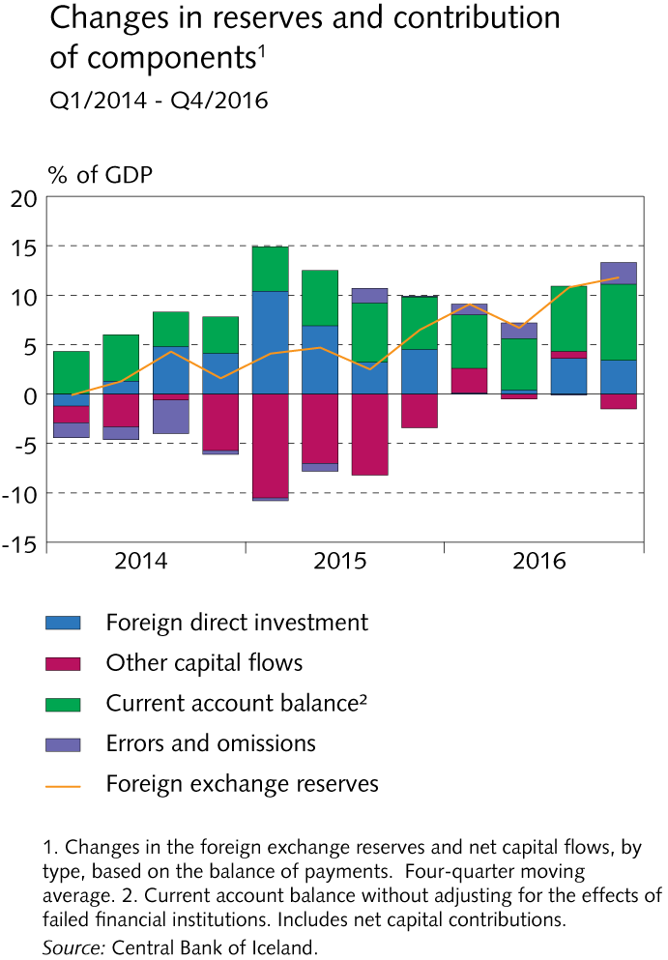

Slide 12
Concluding thoughts
Capital controls in the form of a tax on the buying of domestic bonds by foreign residents has enabled Iceland to have relatively high interest rates.
The high interest rates have accompanied deleveraging by households, firms and the government as well as a turn from a negative to a positive net investment position.
The elevation of the real exchange rate is caused by an increase in exports (tourism), an improvement in the terms of trade and record domestic savings, not by capital inflows.
The current account has been in surplus for eight consecutive years, which is unique in the country’s history.
The current expansion has lasted eight years, the longest in history.

