Slide 1
Creating a CITI Program Account

Slide 2
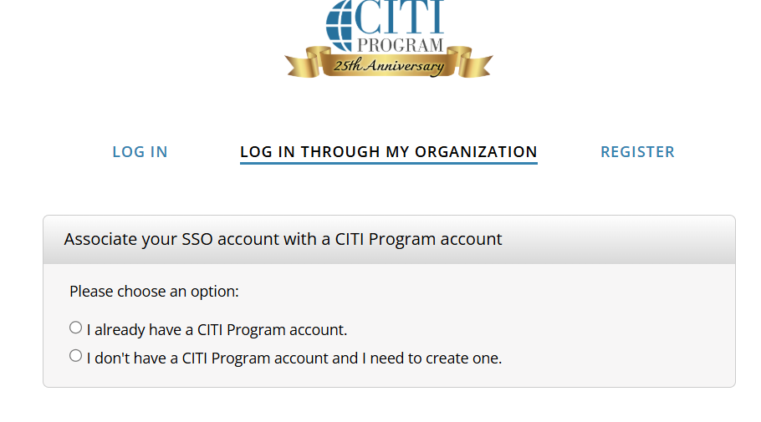

Slide 3
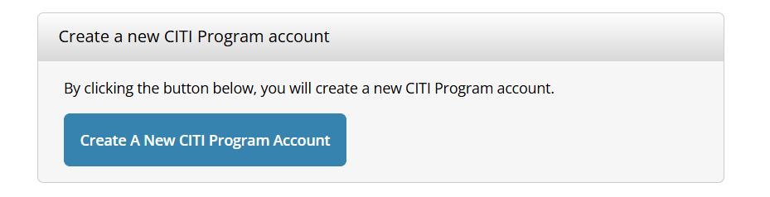

Slide 4
Under "Institution," select “New Jersey Institute of Technology”.
Register your account using your NJIT UCID and email address.

Slide 5
